Slide 1

SC1015 Group 8
HOME
TABLE OF CONTENTS
PLAYLIST
01
Motivation & Problem Formulation
02
Preparing & Cleaning the Data
03
Regression Models
Linear
Random Forest
Gradient Boosting
Lam Hao Fah (U2121999H)
Jovin Ng (U2122252D)
Ng Shang Yau (U2121960G)
04
Conclusion
HOME
Group 8

Slide 2
Table of contents
01
Motivation & Problem Formulation
02
Preparing & Cleaning the Data
Conclusion
03
Regression Models
04
HOME
TABLE OF CONTENTS
PLAYLIST
01
Motivation & Problem Formulation
02
Preparing & Cleaning the Data
03
Regression Models
Linear
Random Forest
Gradient Boosting
04
Conclusion
HOME
Group 8

Slide 3
Motivation & Problem Formulation
01
Motivation & Problem ...
Group 8

Slide 4
Background
01
More than
50%
turned to music during the early stages of the pandemic
Motivation & Problem ...
Group 8

Slide 5
Background
01
- Not everyone listened to music the same
Negative People | Positive People
Used music as a coping mechanism to combat stress and deal with loneliness | Used music as a replacement for social interaction, or to feel connected to others
Motivation & Problem ...
Group 8

Slide 6


01
Motivation
- Shifting music preferences and taste
- The rise of “Corona-music”
- Greater exposure to different songs
= Harder to predict how well a song would do
Motivation & Problem ...
Group 8

Slide 7

Motivation
01
Motivation & Problem ...
Group 8

Slide 8
01
Motivation
- Before an artist releases a song, it will be very helpful to determine how well-received a song would be
Motivation & Problem ...
Group 8

Slide 9
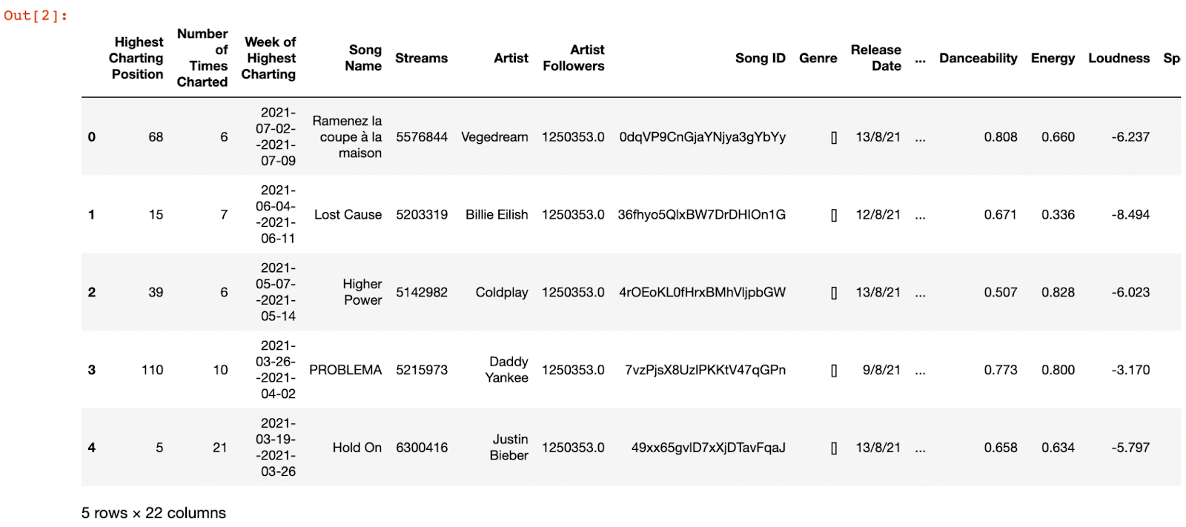
01
Problem Formulation
Which REGRESSION MODEL would be most effective in predicting the number of streams for a song?
“Spotify Top 200 Charts from 2020-2021”
Motivation & Problem ...
Group 8

Slide 10
02
Preparing & Cleaning the Data
Preparing & Cleaning …
Group 8

Slide 11
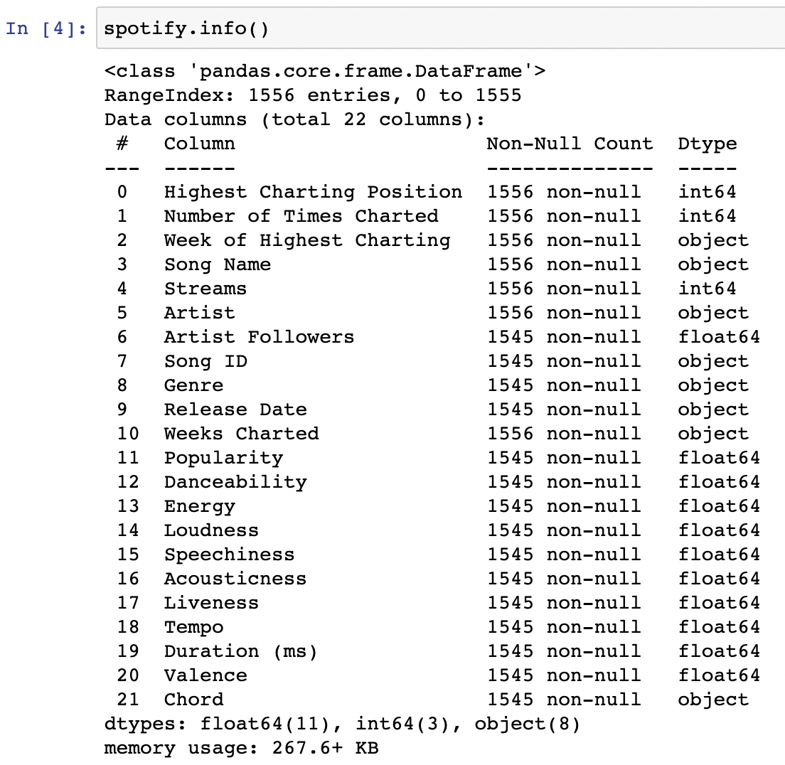
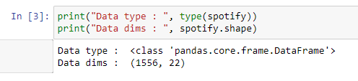
Information of Dataset
02
- Shape: 1556 rows, 22 columns
- Some columns have null values
Preparing & Cleaning …
Group 8

Slide 12
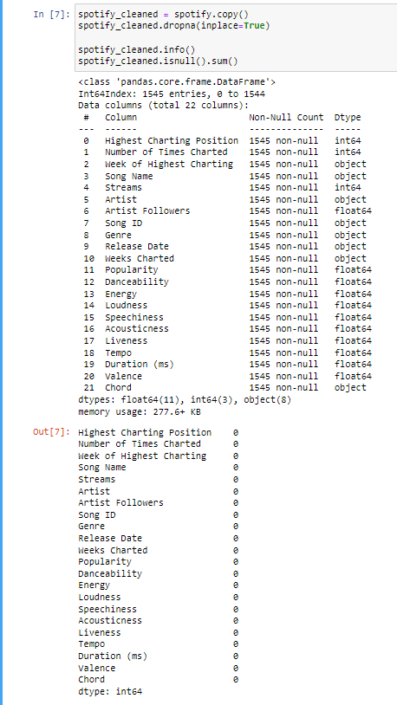
Removal of Null Values
02
Preparing & Cleaning …
Group 8

Slide 13
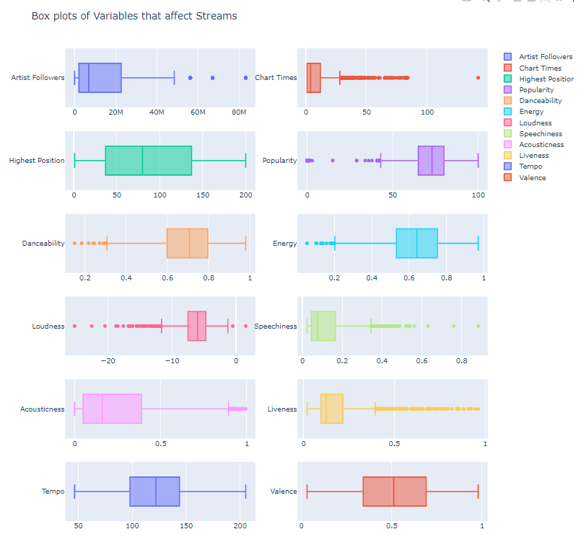
Statistical Exploration
02
- Interactive plots using Plotly
- Predictor Variables: Popularity, Speechiness, Tempo etc.
- Mix of left & right skewed data
Preparing & Cleaning …
Group 8

Slide 14
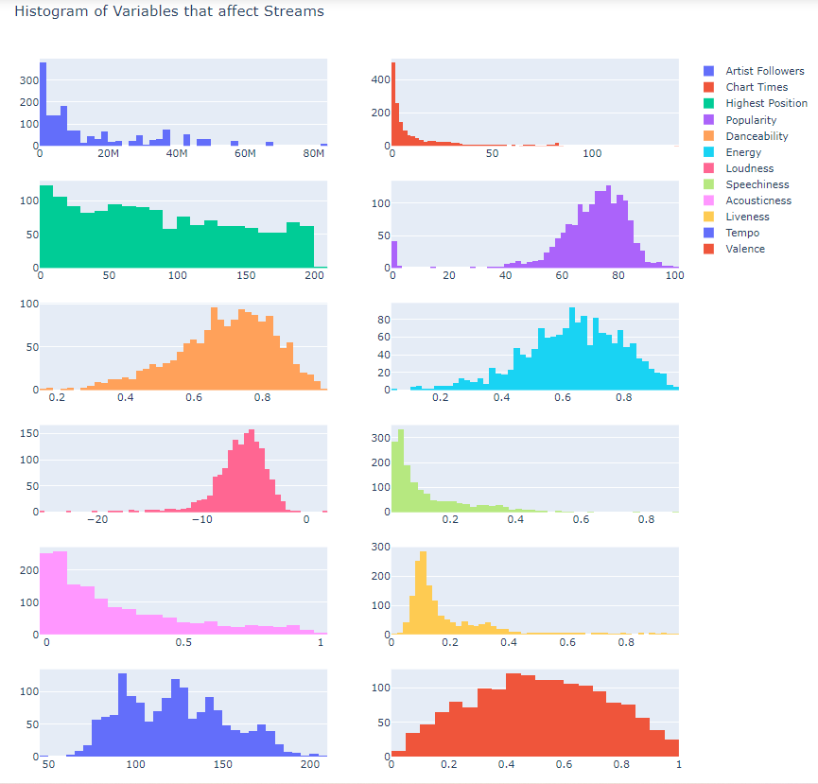
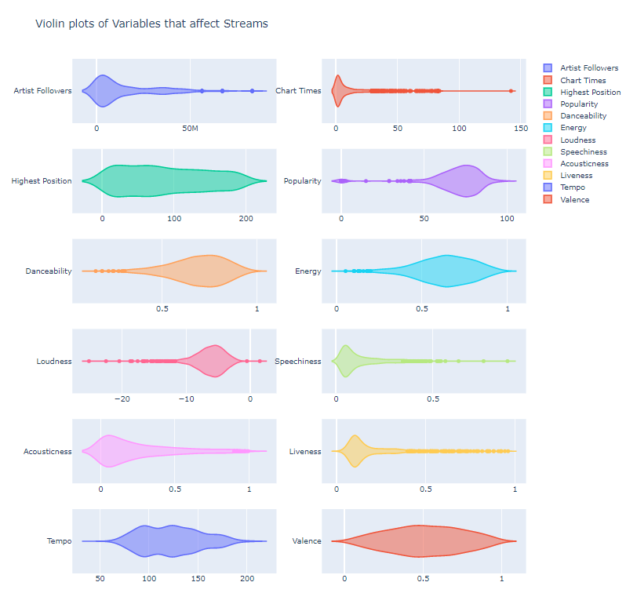
Statistical Exploration
02
Preparing & Cleaning …
Group 8

Slide 15
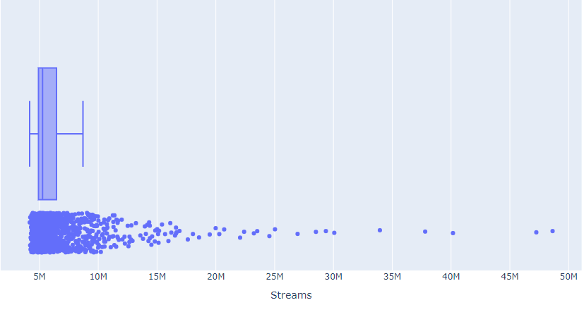
Statistical Exploration
02
- Response Variable: Streams
- Right skewed data
- Mostly congregated within 5M to 7M range
Preparing & Cleaning …
Group 8

Slide 16
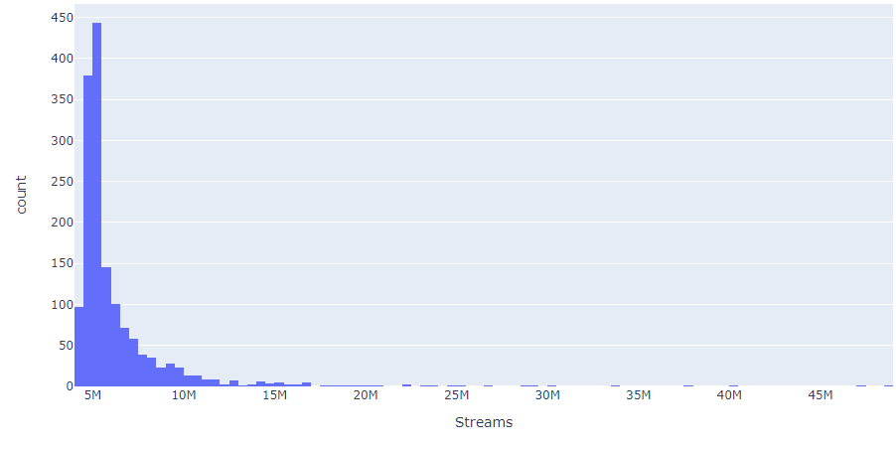
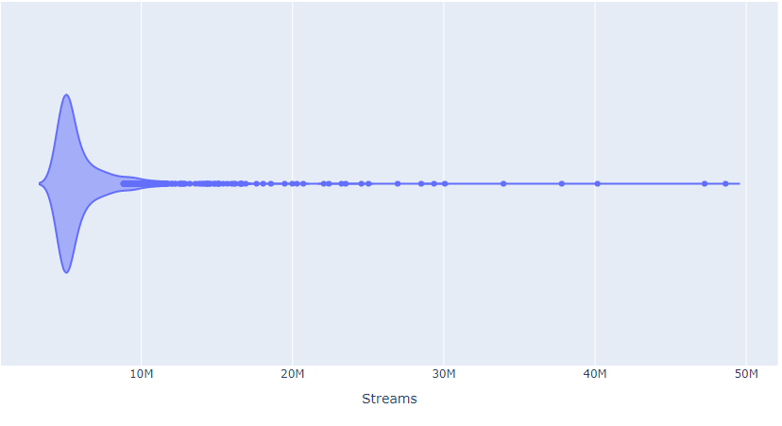
Statistical Exploration
02
Response Variable: Streams
Preparing & Cleaning …
Group 8

Slide 17
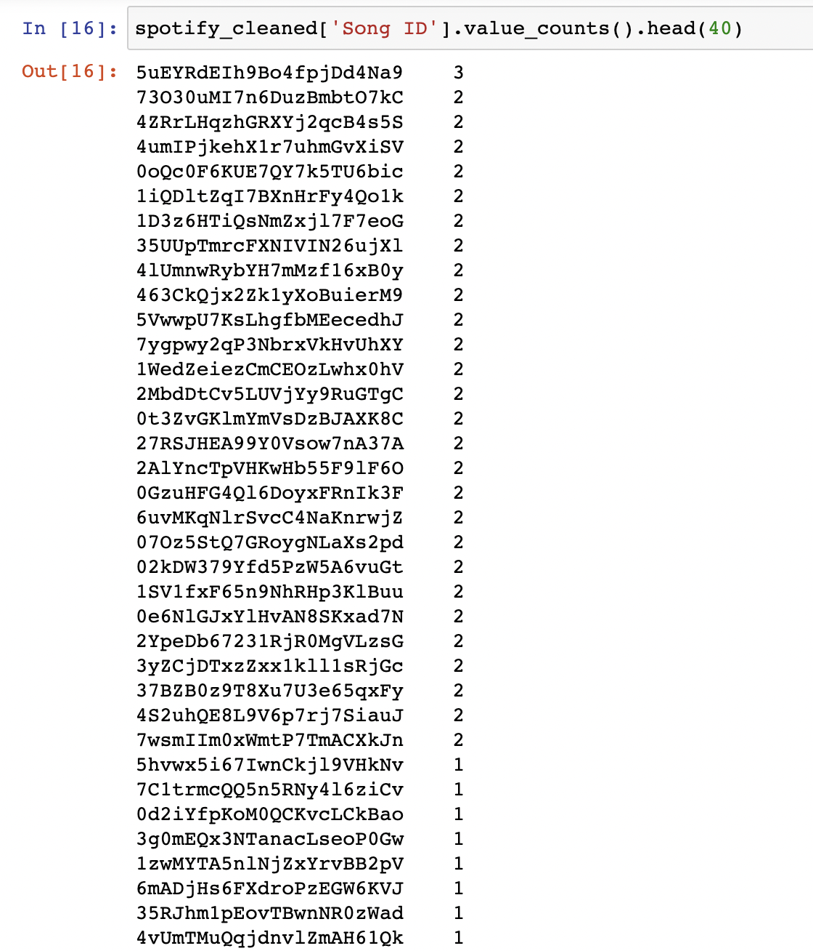
02
Duplicated Song IDs
- Dataset contains duplicated Song IDs
- Total = 29 Songs
Preparing & Cleaning …
Group 8

Slide 18
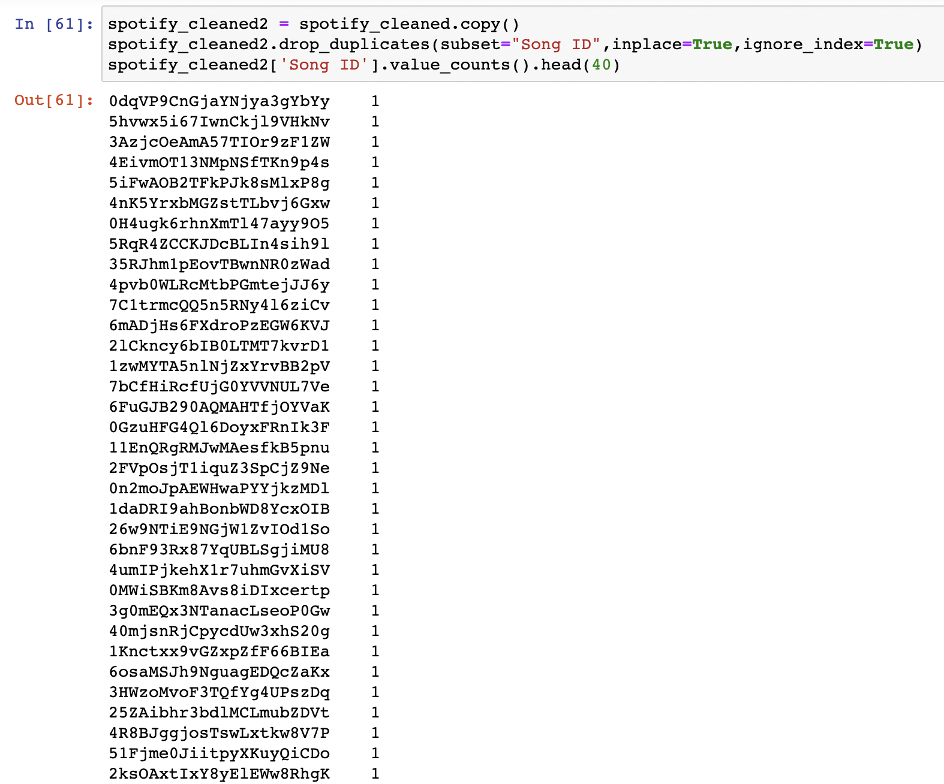
02
Duplicated Song IDs
- “.drop_duplicates” method on column “Song ID”
Preparing & Cleaning …
Group 8

Slide 19
02
“Popularity” Column
- Values of “0” under “Popularity”
- “Popularity” is the cumulative measure of how popular a song is
- Impossible for “Popularity” values to be so low
- Reverse recency bias: Newly released songs not graded fairly for “Popularity”
Preparing & Cleaning …
Group 8

Slide 20
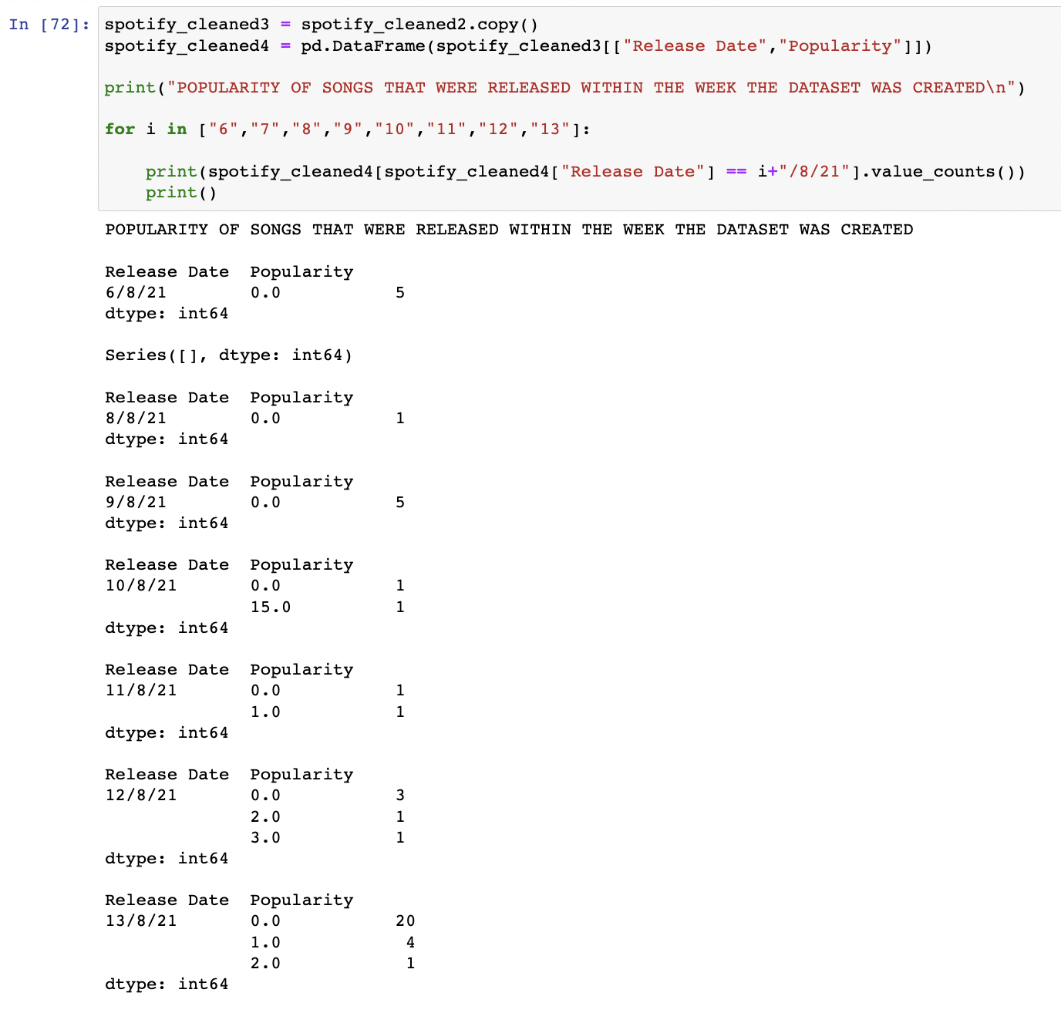
02
“Popularity” Column
- New DataFrame containing only “Release Date” & “Popularity”
- Songs from 6/8/2021 to 13/8/2021 contributed to “Popularity” values of 0, 1, 2, 3 and 15
Preparing & Cleaning …
Group 8

Slide 21
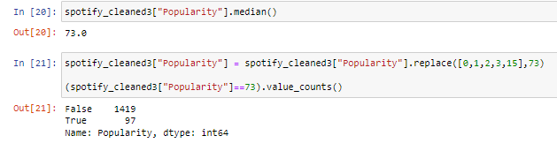
02
“Popularity” Column
Big Question: Should we drop the entire row if “Popularity” column contains the value 0, 1, 2, 3 or 15?
- All 45 recent songs have “Popularity” replaced to the median
Preparing & Cleaning …
Group 8

Slide 22
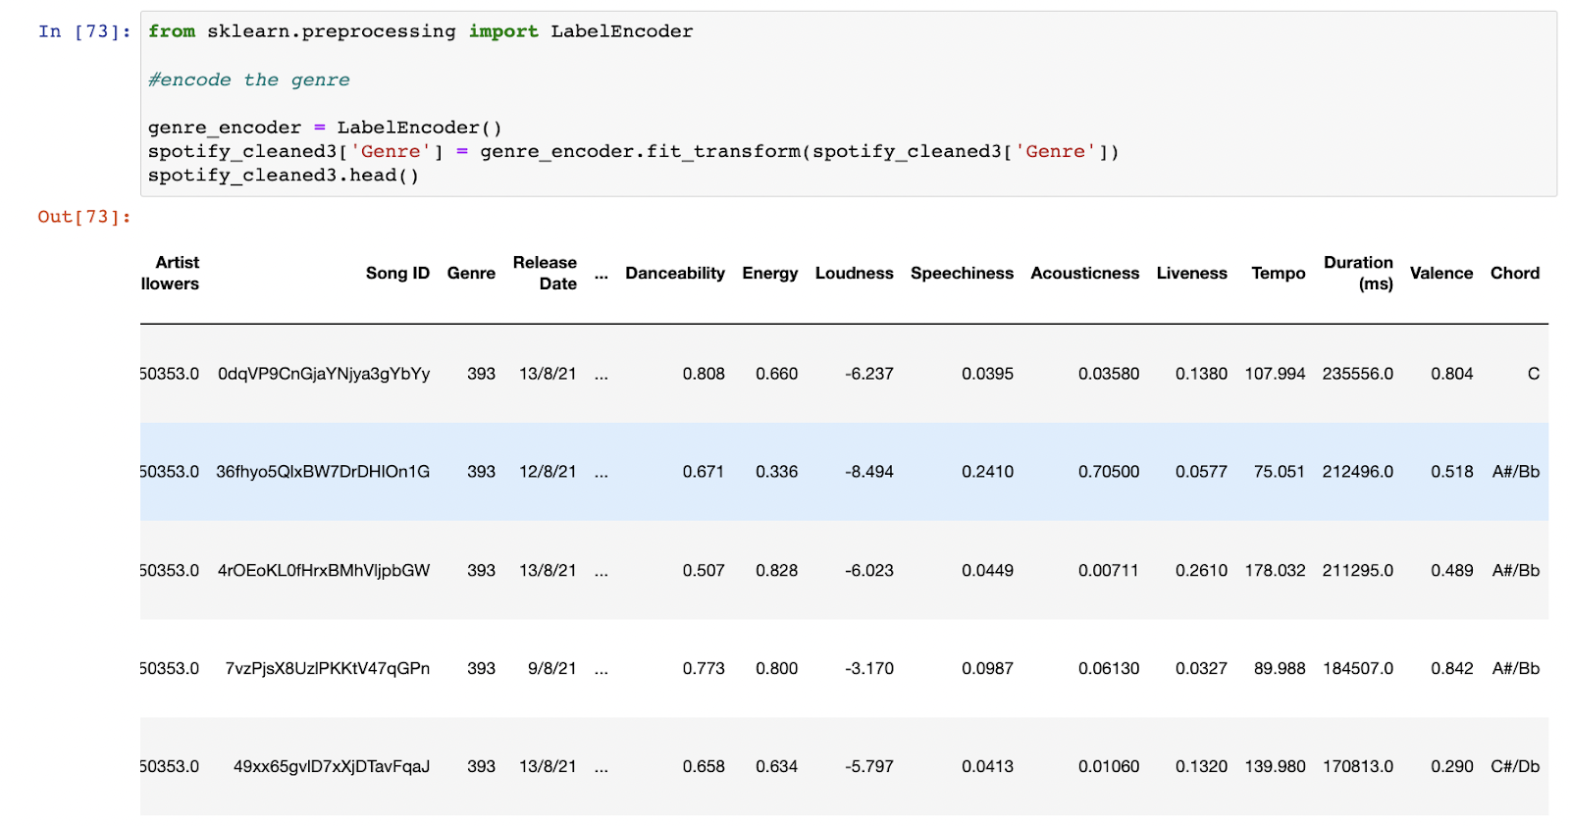
02
Label Encoding - Converts data Categorical → Numerical - 394 unique categories - Changes each unique category into a different numerical value
Encoding for “Genre”
Preparing & Cleaning …
Group 8

Slide 23
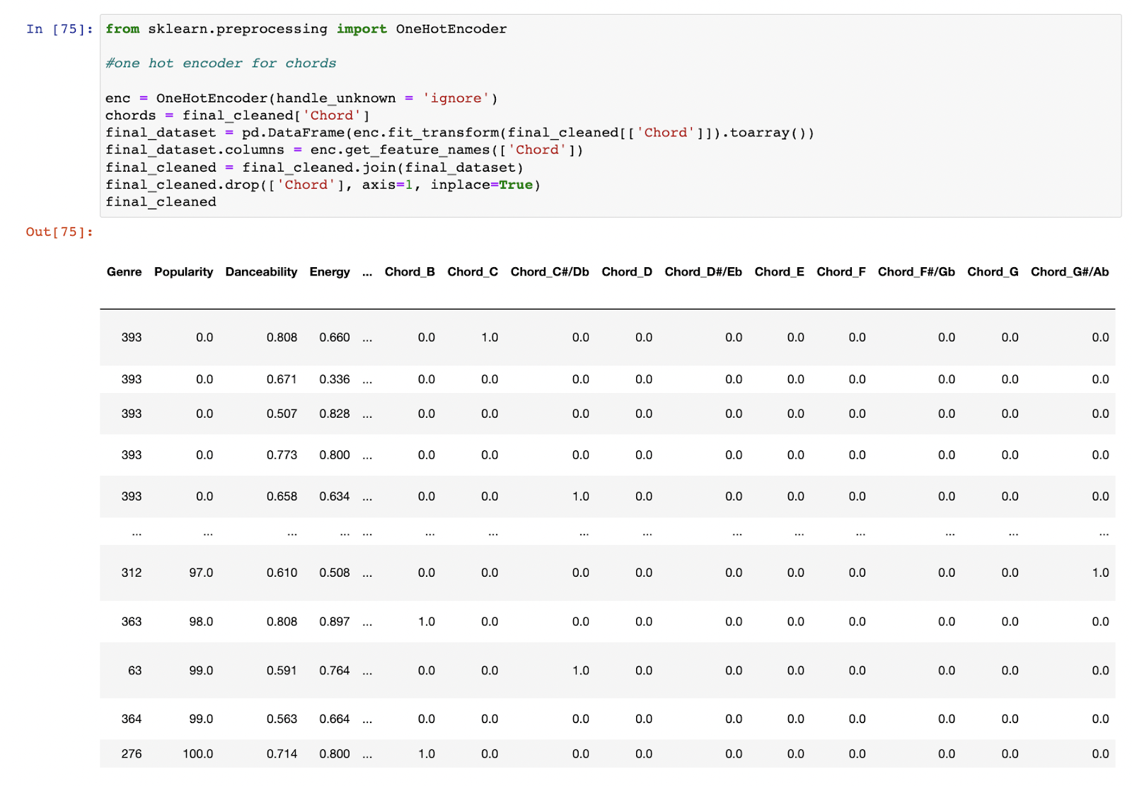
02
Encoding for “Chord”
One-Hot Encoding - Converts data Categorical → Numerical
- Only 9 unique categories
- Generates a separate variable/ column for each unique chord
- Value of “1” will show up in the respective chord’s column, while “0” in the other chords’ columns
Preparing & Cleaning …
Group 8

Slide 24
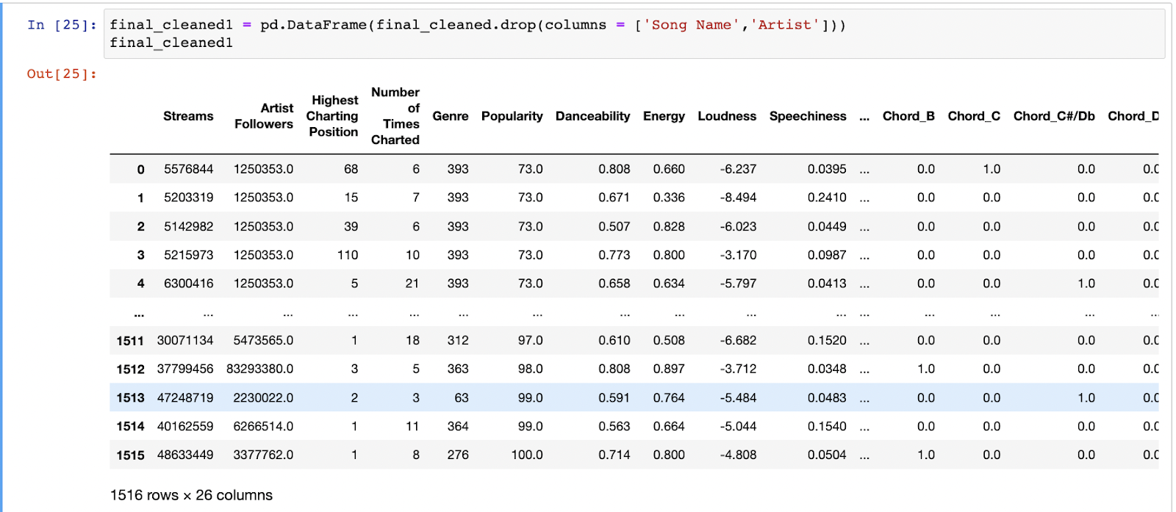
02
“Song Name” and “Artist” were dropped (Insignificant impact and irrelevant in predicting streams)
Dropping Unnecessary Columns
Preparing & Cleaning …
Group 8

Slide 25
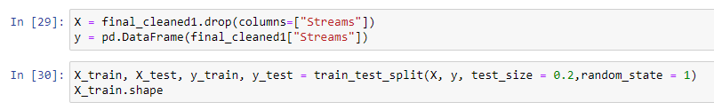
02
Response Variable: “Streams” Predictor Variables:
Preparation of Train/ Test Data
“Artist Followers” | “Highest Charting Position” | “Number of Times Charted” | “Genre”
“Popularity” | “Danceability” | “Energy” | “Loudness”
“Speechiness” | “Acousticness” | “Liveness” | “Tempo”
“Valence” | “Chord A” | … … | “Chord G#/Ab”
Random Split of data: 80% Train – 20% Test (“random_state = 1” is used to control shuffling of the split when used in different notebooks)
Preparing & Cleaning …
Group 8

Slide 26
03
Regression Models
Regression Models
Group 8

Slide 27
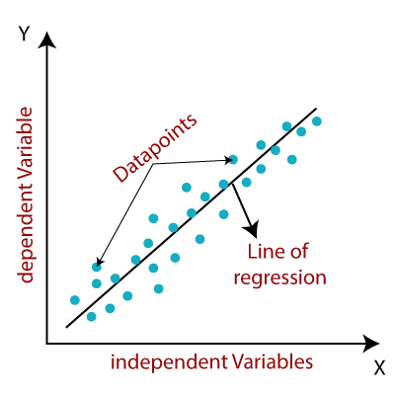
03a
Linear Regression
- A linear model that assumes a linear relationship between the predictor and response variables
Regression Models
Group 8

Slide 28
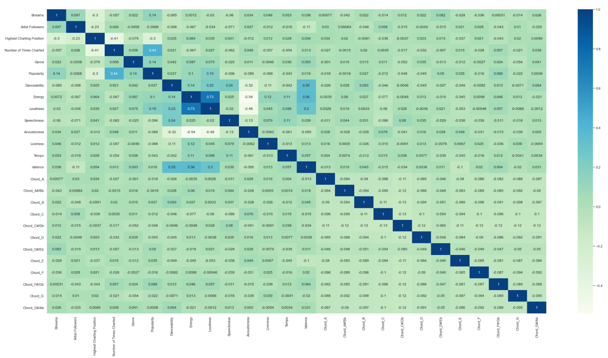
03a
Linear Regression
Plotting a correlation heatmap for all the selected variables
- To check the degree of correlation between each variable
- 0.3
Regression Models
Group 8

Slide 29
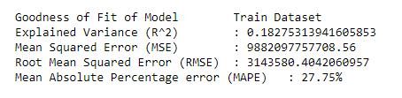
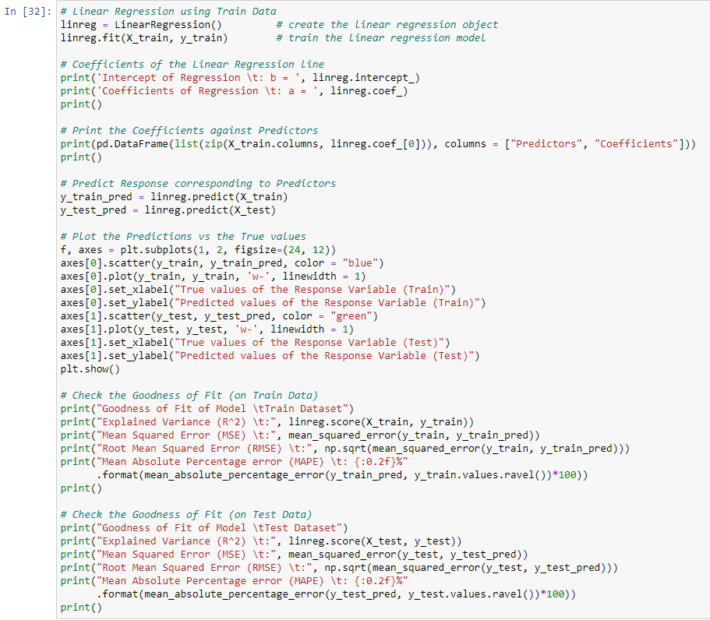
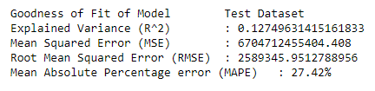
03a
Fitting linear regression model using “train” data
Linear Regression
Predicting “Streams” from “train” data
Predicting “Streams” from “test” data
Regression Models
Group 8

Slide 30
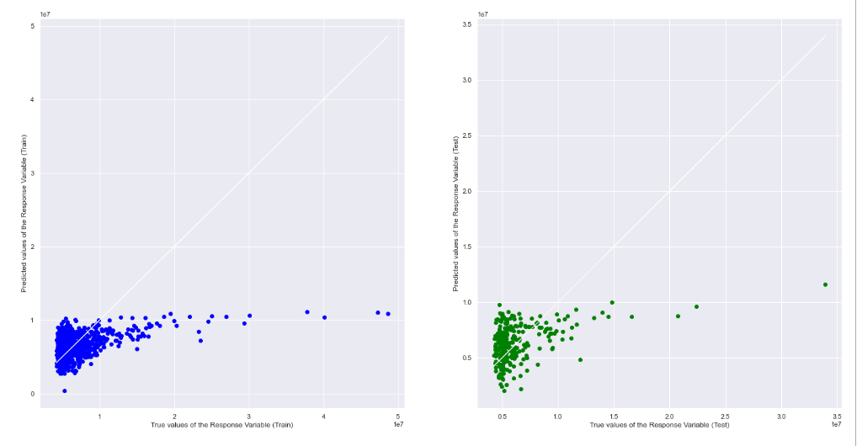
03a
Linear Regression
Predicted VS True values
Train dataset
Test dataset
Regression Models
Group 8

Slide 31
03a
MEAN ABSOLUTE PERCENTAGE ERROR
(MAPE)
- Will be used subsequently as our main indicator of model accuracy
- Measurement of average difference between predicted and actual values
- MAPE, model accuracy
- Improves readability as it is scale independent
Regression Models
Group 8

Slide 32
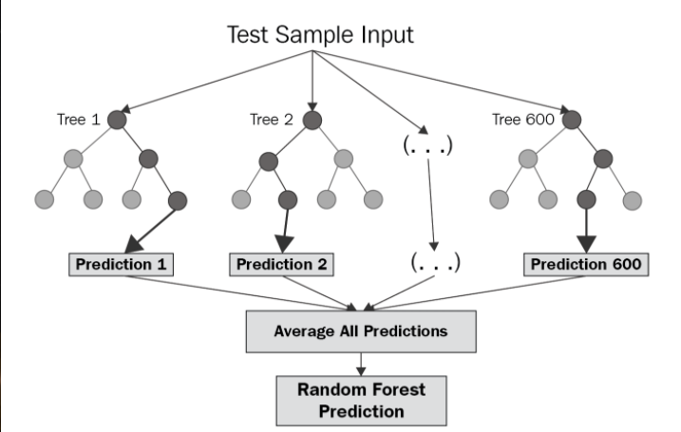
03b
Random Forest Regression
- Uses different independent regression decision trees to individually predict expected streams
- Calculates average of all predictions to generate an “ultimate” prediction
- Quick to train + High Prediction Accuracy
- Less sensitive to noise
Regression Models
Group 8

Slide 33
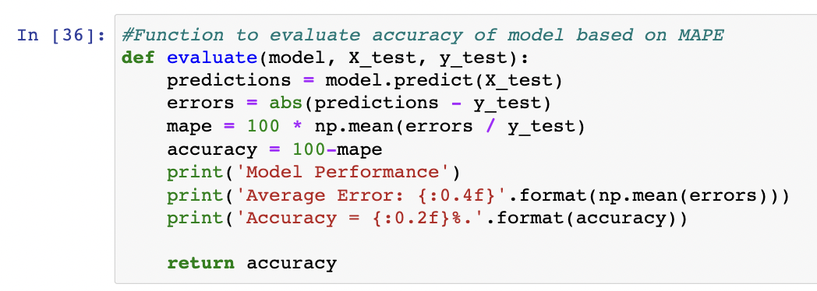
03b
Random Forest Regression
- Helps calculate and print out average error and accuracy of any given model
Regression Models
Group 8

Slide 34
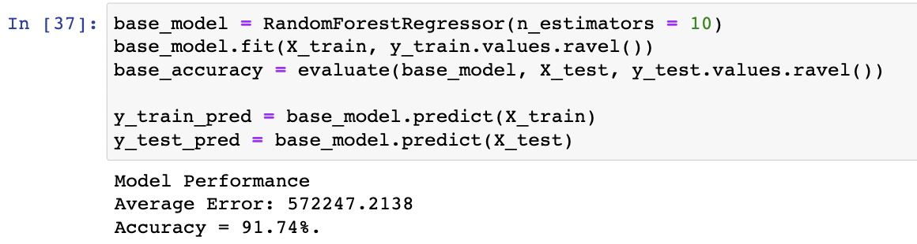
03b
Random Forest Regression
Regression Models
Group 8

Slide 35
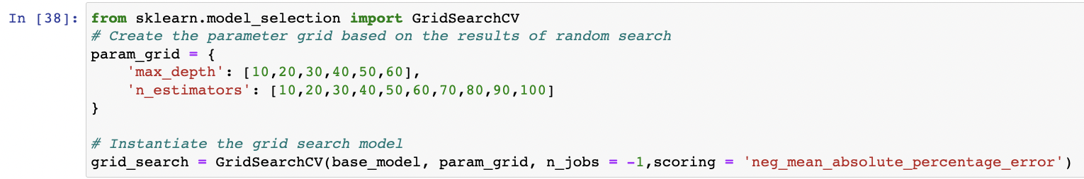
03b
Random Forest Regression
- Tuned hyperparameters using grid search cross validation
- Cross validation was done based on which parameters would result in the highest average MAPE
Regression Models
Group 8

Slide 36
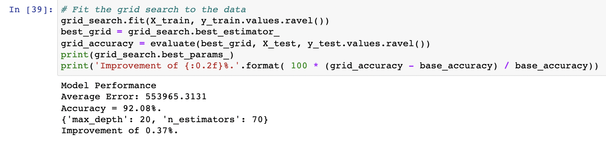
03b
Random Forest Regression
Regression Models
Group 8

Slide 37
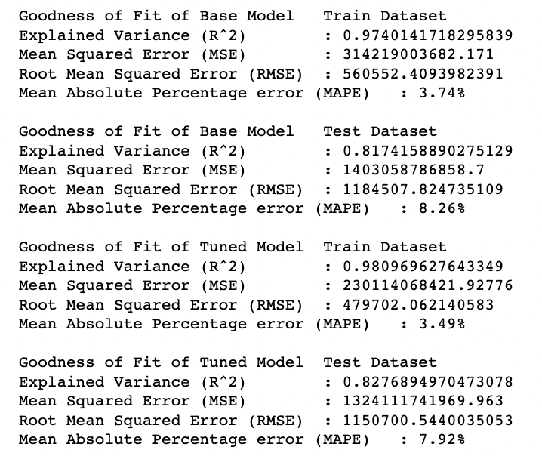
03b
Random Forest Regression
Linear | Random Forest Regressor
RMSE: Train: 3.1M Test: 2.5M | RMSE: Train: 480k Test: 1.2M
Regression Models
Group 8

Slide 38
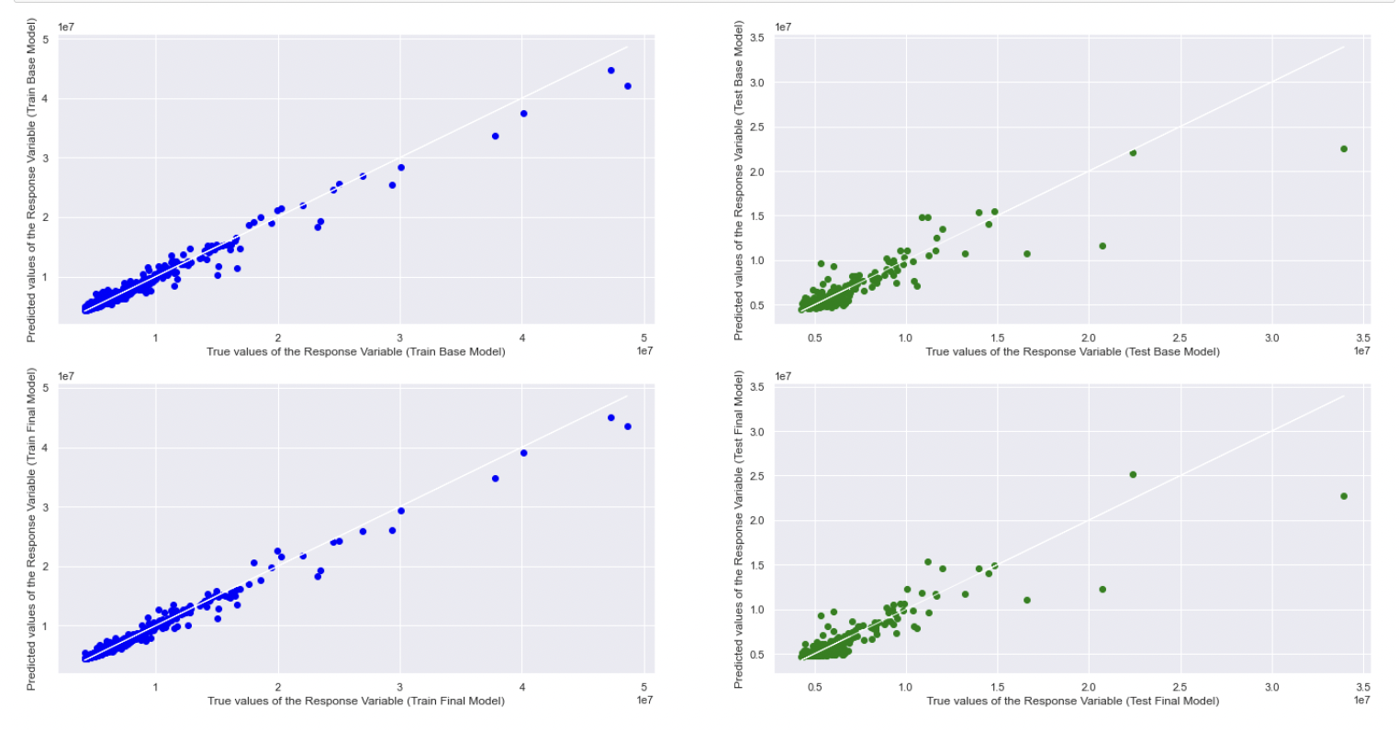
03b
Random Forest Regression
Regression Models
Group 8

Slide 39
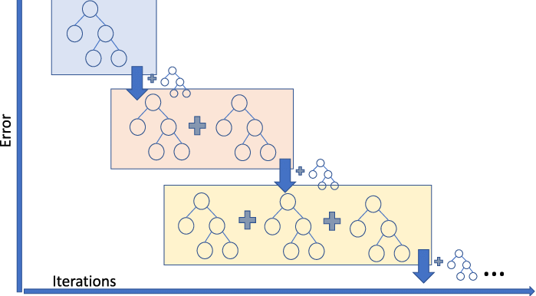
03c
Gradient Boosted Regression
- Builds one tree at a time, where new tree helps to correct errors made in the previous tree
- Highly accurate + Ability to identify feature importance
- More sensitive, can easily overfit to noise
- Longer model training duration
Regression Models
Group 8

Slide 40
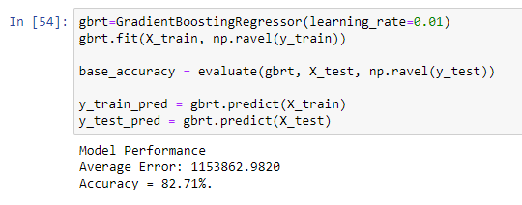
03c
Gradient Boosted Regression
Regression Models
Group 8

Slide 41
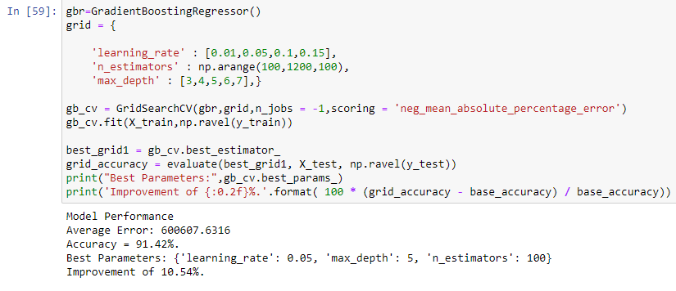
03c
Gradient Boosted Regression
- Hyperparameters identified: Learning rate, n_estimators, max_depth
- Tuned using grid search cross validation
Regression Models
Group 8

Slide 42
03c
Gradient Boosted Regression
Regression Models
Group 8

Slide 43
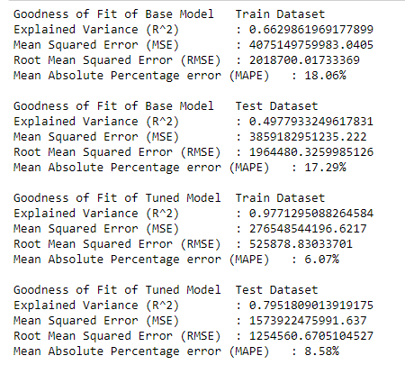
03c
Gradient Boosted Regression
Linear | Gradient Boosted
RMSE: Train: 3.1M Test: 2.5M | RMSE: Train: 525K Test: 1.25M
Regression Models
Group 8

Slide 44
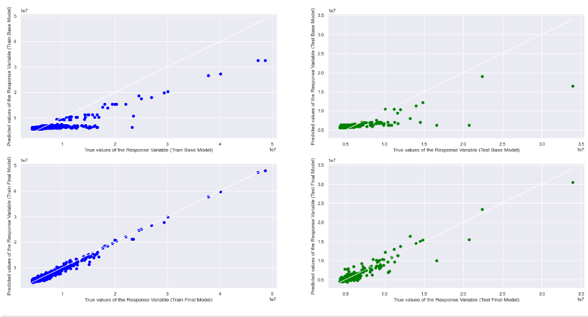
03c
Gradient Boosted Regression
Regression Models
Group 8

Slide 45
04
Conclusion
Conclusion
Group 8

Slide 46
04
Conclusion
- Both models are more effective than linear model
Random Forest Regressor Model
Gradient Boosted Regression
Conclusion
Group 8

Slide 47
04
Conclusion
Random Forest Regressor Model is the most efficient and cost-effective model to predict how well a song would do in terms of its streams
Conclusion
Group 8

